Slide 1
Credit Card Fraud
Daniel Bentall, Blake List, Ben Faulks, Sid Bhatnagar
https://www.kaggle.com/mlg-ulb/creditcardfraud

Slide 2
Context
Transactions from European cardholders occurring over two days in September 2013
284,807 transactions, 492 are fraudulent
Only 0.172% of transaction data is fraudulent
Class imbalance!

Slide 3
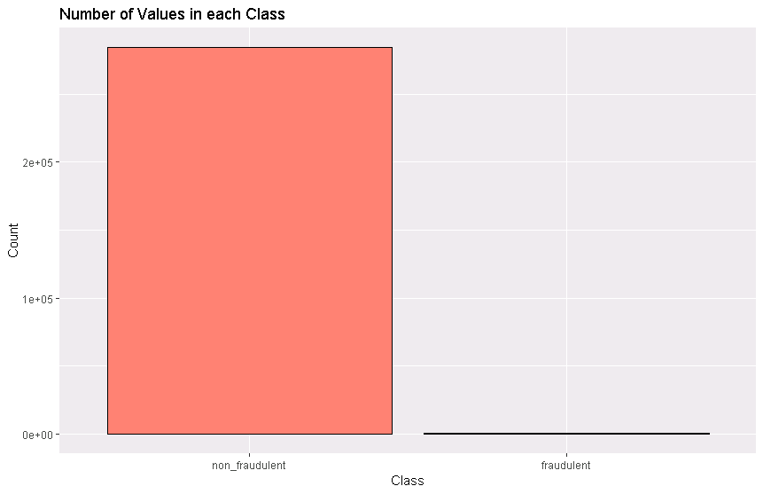

Slide 4
Features
31 columns, 284,807 rows
Time: seconds elapsed since beginning
V1 - V28: principle components
Amount: transaction amount
Class: 1 = fraudulent, 0 = non-fraudulent

Slide 5
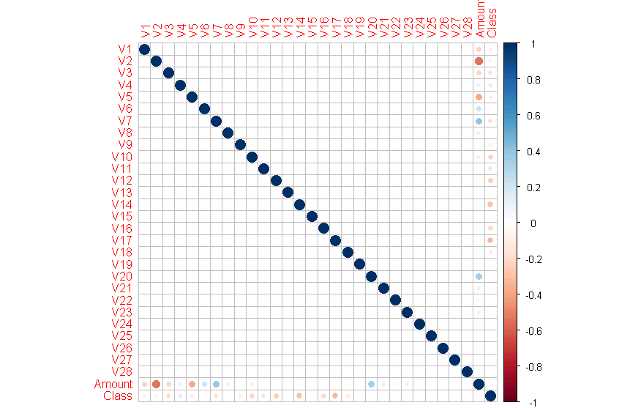

Slide 6
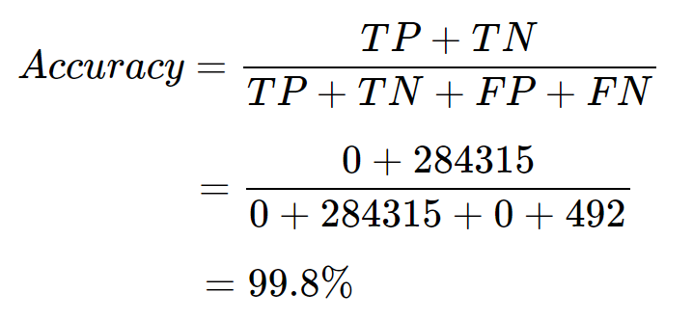
The Problem with Accuracy
 |  | Actual Class
 |  | Positive: Fraud | Negative: Non-fraud
Predicted Class | Pos | True Pos: 0 | False Pos: 0
 | Neg | False Neg: 492 | True Neg: 284315

Slide 7
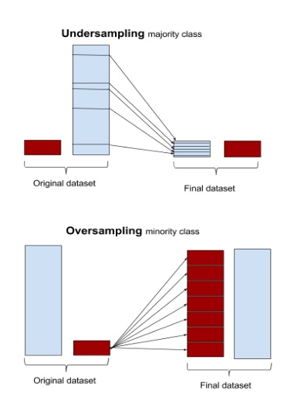
Undersampling and Oversampling

Slide 8
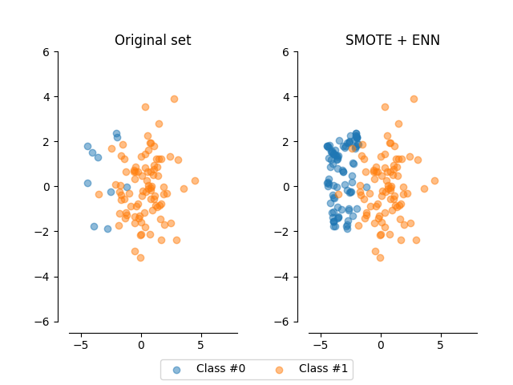
Synthetic Oversampling:
SMOTE
Synthetic Minority Over-sampling Technique
ROSE
Random Over-Sampling Examples

Slide 9
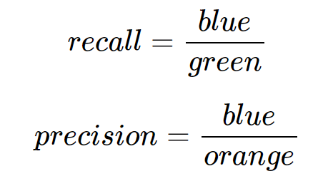
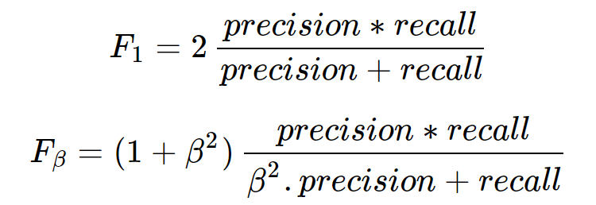
F-beta-Score:
Precision &
Recall
 |  | Actual Class
 |  | Positive: Fraud | Negative: Non-fraud
Predicted Class | Pos | True Pos | False Pos
 | Neg | False Neg | True Neg

Slide 10
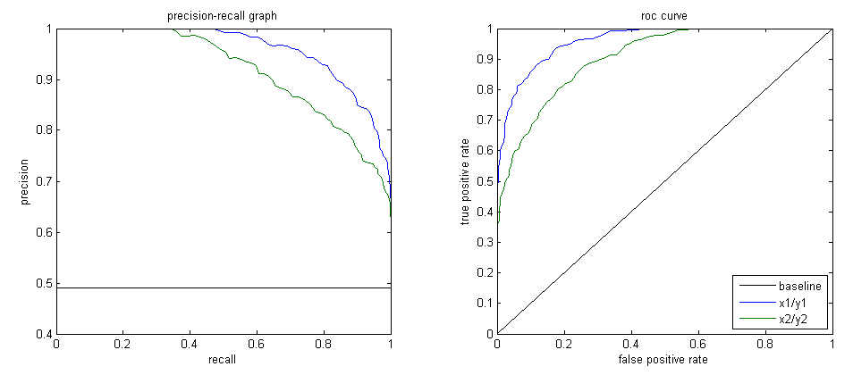
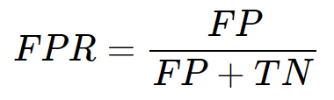
ROC Curve vs. PR Curve

Slide 11
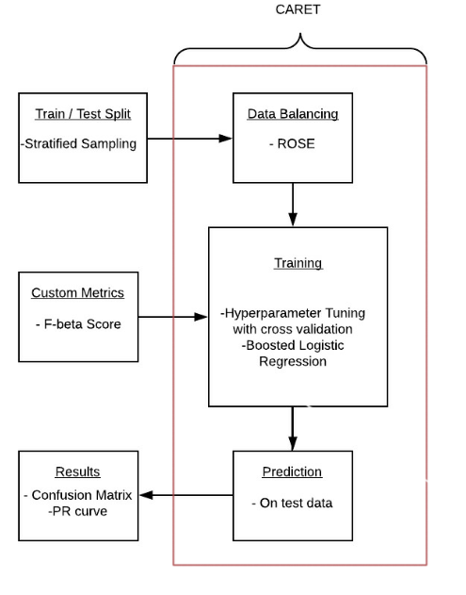
Method

Slide 12
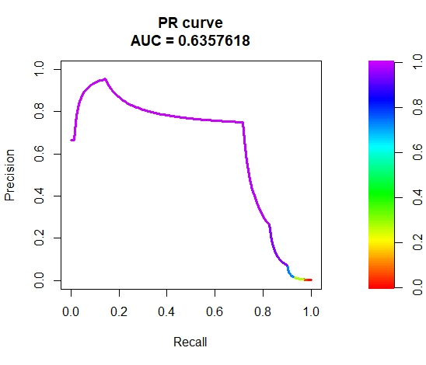
Undersampling

Slide 13
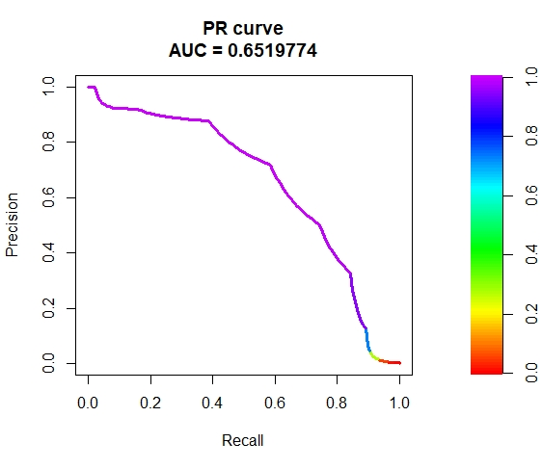
Oversampling

Slide 14
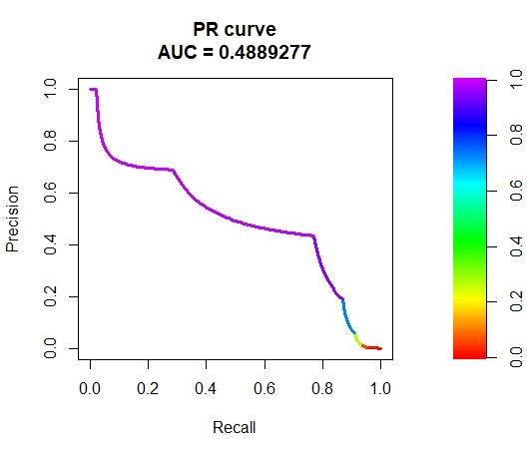
SMOTE

Slide 15
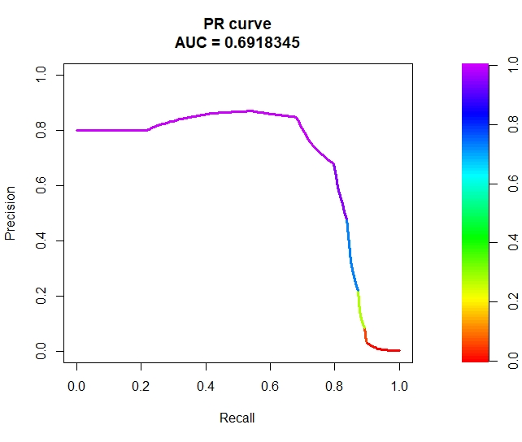
ROSE

Slide 16
Confusion
Matrix
Non-Fraudulent: 84864
Fraudulent: 577
Prediction - ROSE | Actual Fraudulent | Actual Non-fraudulent
Fraudulent | 128 | 449
Non-fraudulent | 19 | 84845
Precision: 0.221837
Recall: 0.870748

Slide 17
Moving Forward...
Business Use
Decide on cost model for FP and FN to choose beta
Ways to improve the model
Obtain more data
Experiment with further dimensional reduction
Explore possibility of concepts within classes
Test different methods of cost sensitive learning

Slide 18
Moving Forward...
Class imbalance is a common issue in applied data science!
Not just credit card fraud detection
Medical diagnosis, rare events, e.g. volcanic eruptions, extreme weather

Slide 19
Summary
Balancing
Undersampling
Oversampling
SMOTE
ROSE
Cost sensitive learning
Precision
Recall
F Beta
Our method
CARET
ROSE
Boosted Logistic Regression

